Slide 1
The PAW Survival Guide
Deploying Secure Admin Workstations in Real Environments

Slide 2
Attention
MMS sessions are 60-75 minutes followed by LONG Q&A
Please hold detailed questions until that Q&A starts
Feel free to ask clarification questions
Remind the speakers to use Zoom It when you can’t see

Slide 3

Mikael Nystrom
Microsoft MVP
deploymentbunny@outlook.com
@mikael_nystrom

Slide 4
Lets begin smiling...☺
Since many of you will be depressed once you understand how this should be done...

Slide 5
Session outcomes
Understand practical PAW architectures and design trade-offs
Integrate PAW into modern identity, Entra ID, and Zero Trust models
Learn from real-world PAW failures and recoveries
Operate PAW at scale without killing usability
Avoid common deployment pitfalls
Notes:
Stress practicality and field lessons.

Slide 6
Agenda (75 minutes)
Why PAW exists and what it actually protects
PAW architectures: classic, modern, hybrid
Identity + Zero Trust integration
Field lessons: what goes wrong in real deployments
Operating PAW at scale
Q&A
Notes:
Mention adaptable pacing: can shorten for 60 min.

Slide 7
Why?

Slide 8
The attack reality
Most domain compromises start from a workstation
Credential theft enables lateral movement and privilege escalation
Admin endpoints are high-value targets
EDR does not compensate for credential exposure
PAW isolates privileges from daily user risk
Notes:
Connect to earlier OS hardening session if relevant.

Slide 9
What PAW protects
Privileged credentials
Administrative tokens
High-trust sessions
Access paths to Tier 0/1 assets
Management planes (on-prem + cloud)
Notes:
Clarify: PAW protects *where* you log on, not just *what* you log on to.

Slide 10
Demo
Prep for PAW in Active Directory

Slide 11
Demo
Prep for PAW in Entra ID

Slide 12
PAW architectures
Classic, modern, and hybrid designs

Slide 13
Classic PAW
Dedicated hardened workstation
Blocked internet + email
Tiered admin model
Domain-joined
Strong but rigid
You might need many devices to uphold isolation
Notes:
Describe original Microsoft PAW guidance.

Slide 14
Modern PAW
Dedicated hardened workstation
Entra ID joined
Strong device compliance
MFA-bound access
Conditional Access enforced
Better usability, more dependencies
You might need many devices to uphold isolation
Notes:
Highlight Entra ID + Conditional Access.

Slide 15
Hybrid PAW (real-world choice)
Hardware is a “portable” Hypervisor
Not Domain joined
Managed?
Often intentionally minimal or separate control plane
Locked down and useless for other tasks then running VMs
Notes:
State clearly: 90% of customers land here.

Slide 16
Hybrid PAW (real-world choice)
Virtual Machines for each tier
Virtual Machines for each management interface
Virtual Machine for each cloud platform
Notes:
State clearly: 90% of customers land here.

Slide 17
Demo
The PAW Toolkit, let us build some PAWs

Slide 18
Identity & Zero Trust
Making PAW part of the access model
Truesec

Slide 19
PAW in a Zero Trust model
Never trust the network
Always verify device + identity
Assume credentials will be attacked
Isolate administration
Continuously evaluate risk
Notes:
Position PAW as a Zero Trust enforcement point.

Slide 20
Identity integration
Separate admin identities
Conditional Access: PAW-only access
MFA and phishing-resistant auth
Role-based access
JIT/JEA and least priv.
Privileged Identity Management (PIM)
PIM reduces standing privilege and adds control — but it does not replace PAW or prevent credential theft.
Notes:
Make clear PAW without identity separation fails.

Slide 21
Lessons from the field
What breaks, why, and how to fix it

Slide 22
Common PAW failures
PAW is not the starting point
it’s an enforcement mechanism!
Admins bypass PAW due to friction
PAW too restricted to do the job
Internet/email exceptions creep in
No lifecycle management
Notes:
These are lived experiences.

Slide 23
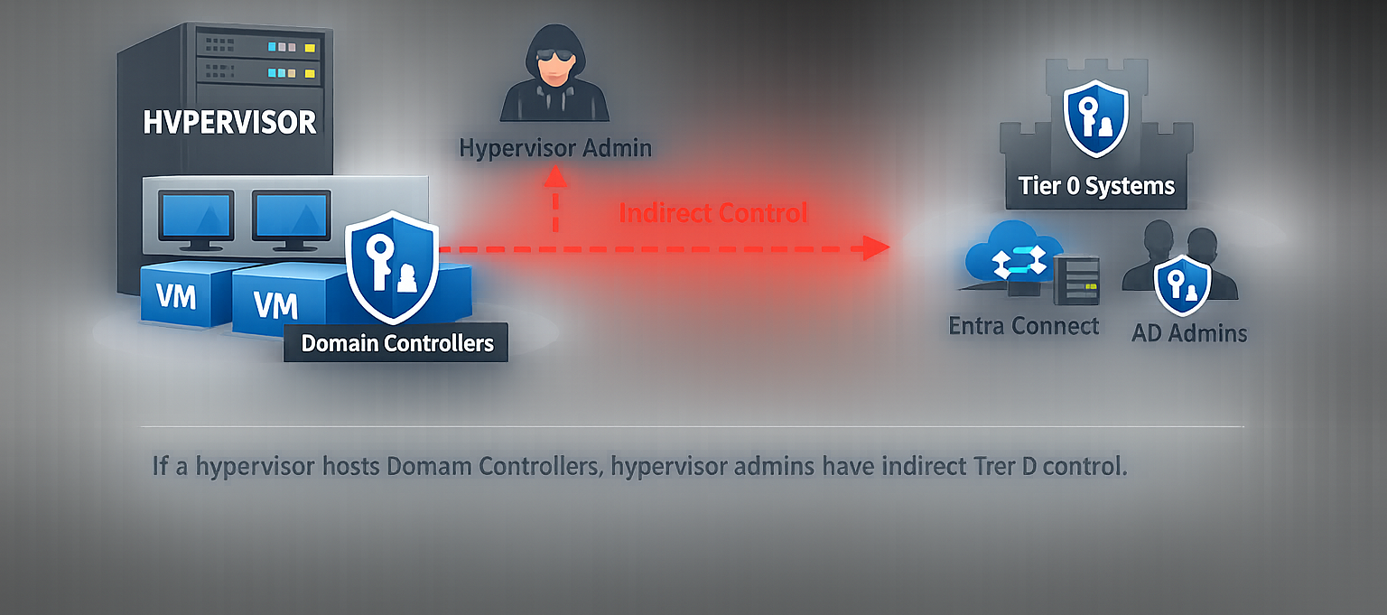

Slide 24
Common PAW failures
PAW treated as a one-time project
Trying too hard
Trying too much
Try to0 fix corner cases
Indirect administrative control defines Tier 0
Notes:
These are lived experiences.

Slide 25
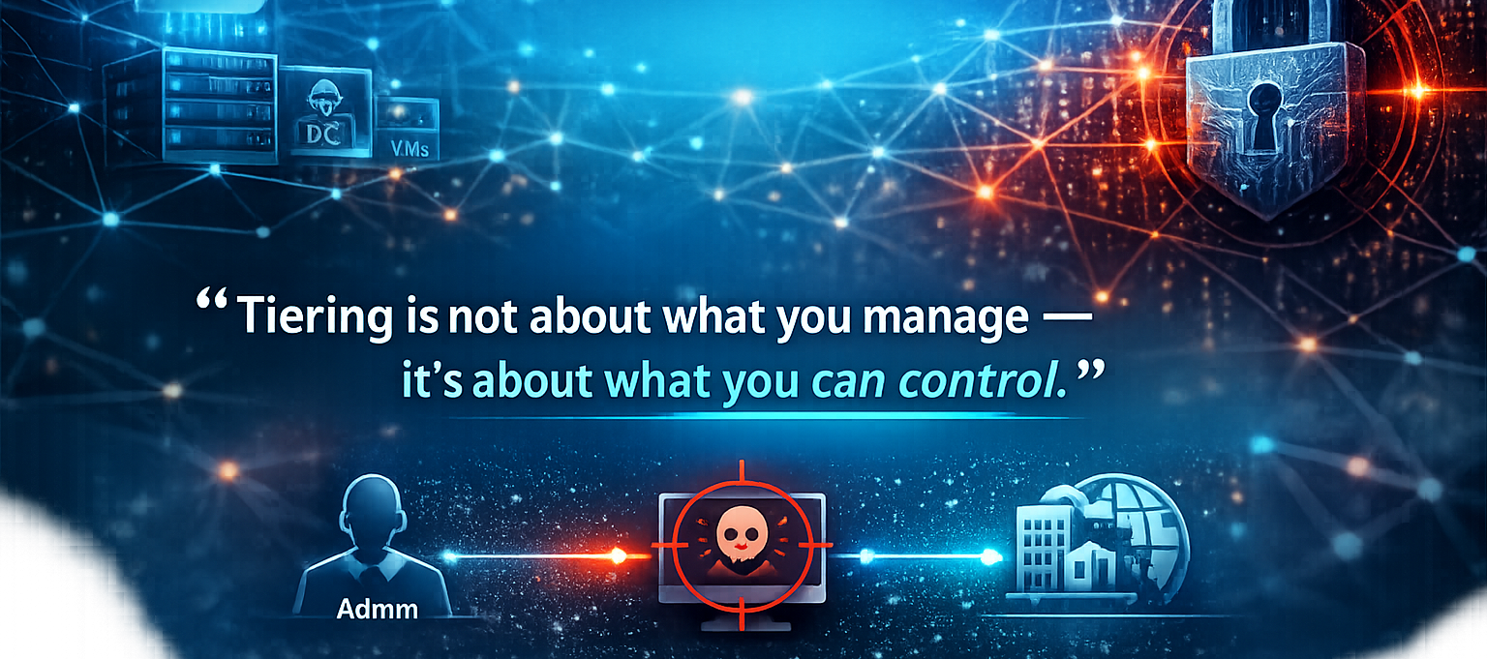
Remember this...

Slide 26
What successful deployments do differently
Start from the top
Tier 0
Backup
Entra ID
Virtualization
Executive sponsorship
Clear admin workflows
Dedicated PAW persona
Change management
Continuous improvement
Notes:
Stress people and process, not just tech.

Slide 27
Operating PAW at scale
From pilot to production

Slide 28
PAW operational model
Ring-based deployment
Clear onboarding/offboarding
Update and patch strategy
Tooling standardization
Incident response for PAWs
Notes:
PAW is a service, not a device.

Slide 29
Balancing security and usability
Fast login and boot
Minimal tool sprawl
Documented workflows
Measured exceptions
Feedback loops with admins
Notes:
If PAW is painful, it will be bypassed.

Slide 30
Final thoughts
What actually matters

Slide 31
If you do only 5 things
Separate admin identities
Enforce PAW-only access via policy
Harden the PAW OS aggressively
Remove internet/email from PAW
Treat PAW as an ongoing program
Notes:
Use this as a practical takeaway slide.

Slide 32
PAW Decision Matrix – Who Needs PAW?
Role | Typical Access | Credential Exposure Impact | Internet / Email Needed | PAW Required? | Notes
Tier 0 Admin (AD / Entra) | DCs, Entra ID, AAD Connect | Total domain compromise | No | ✅ Mandatory | Dedicated PAW only
Server / Infrastructure Admin | Servers, hypervisors | Lateral movement + service compromise | Rare | ✅ Strongly Recommended | PAW or hardened admin device
Security Operations | EDR, identity, IR tools | Security control bypass | Limited | ✅ Recommended | Depends on tools used
Cloud / M365 Admin | Tenant-wide config | Tenant takeover | Sometimes | ✅ Recommended | CA + compliant device minimum
Helpdesk / Desktop Support | Endpoints, users | User compromise | Yes | ⚠️ Optional | JIT + strong controls may suffice
Standard Users | Business apps | Low | Yes | ❌ No | Never grant admin rights
Notes:
Use this slide to stop over‑deployment of PAW while protecting high‑risk roles. Key message: PAW is mandatory for Tier 0, strongly recommended for infrastructure/admin planes, and usually not needed for standard users. Match PAW to credential blast radius.

